Slide 1
Capstone Project
Project Title
Image Classification Model
Presented By :
Name : Ujjwal Raj
College Name : Bhagalpur College of Engineering
Department : Computer Science & Engineering

Slide 2
Outline
Problem Statement
Proposed Solution
System Development Approach
Algorithm and Development
Data Collection and Preprocessing
Model Selection and Architecture
Training The Model
Evolution Matrix and Result
Result
Sample Predictions
Conclusion
Future Scope
References

Slide 3
Problem Statement
In today's digital landscape, automating the classification and interpretation of images is crucial for various applications, including medical diagnostics and content moderation. Current methods for image classification often suffer from inefficiencies and errors, highlighting the need for a more reliable and automated system to accurately categorize images into predefined classes

Slide 4
Proposed Solution:
Develop a robust image classification model capable of categorizing images into predefined classes.
Achieve high accuracy in classification tasks while minimizing errors.
Implement and evaluate various machine learning models to determine the most effective approach for image classification.

Slide 5
System Development Approach
1. Problem Definition
Objective: Develop an image classification model.
Application: Real-world scenarios like medical imaging, facial recognition.
2. Data Collection
Source: Public datasets (e.g., CIFAR-10, ImageNet).
Preprocessing: Resizing, normalization, data augmentation.
3. Model Selection
Architecture: Convolutional Neural Network (CNN).
Reason: Effective for image data, proven performance.
4. Training the Model
Environment: GPU-based setup, TensorFlow/PyTorch.
Hyperparameters: Learning rate, batch size, epochs.
Process: Data augmentation, optimizer (Adam), loss function (cross-entropy).

Slide 6
5. Evaluation
Metrics: Accuracy, precision, recall, F1-score.
Validation: Cross-validation, confusion matrix analysis.
6. Deployment
Strategy: Cloud deployment via AWS/GCP, REST API for inference.
Scalability: Designed for high-load scenarios.
7. Challenges and Solutions
Data Imbalance: Used data augmentation, oversampling.
Overfitting: Applied dropout, regularization.
8. Future Work
Improvements: Fine-tuning, exploring different architectures.
Applications: Extend to other domains like autonomous driving.

Slide 7
ALGORITHM & DEPLOYMENT
Data Collection and Pre-processing
Data Source: The project utilizes the CIFAR-10 dataset, comprising 60,000 32x32 color images in 10 classes, or MNIST with 70,000 28x28 grayscale images in 10 classes.
Dataset Details: CIFAR-10 includes 60,000 images divided into 10 classes (e.g., airplane, automobile, bird, etc.), with each class containing 6,000 images. MNIST has 70,000 images of handwritten digits (0-9), with 7,000 images per digit.
Pre-processing Steps: Normalization scales pixel values to a range suitable for the model. Resizing adjusts image dimensions to match input requirements. Augmentation enhances dataset size via techniques like rotation and flipping, improving model generalization.

Slide 8
Model Selection and Architecture:
Model Choice: Convolutional Neural Networks (CNNs) are selected for their effectiveness in image classification tasks, leveraging their ability to automatically learn features from image data.
Architecture Overview: CNNs typically consist of convolutional layers that extract features, pooling layers that reduce spatial dimensions, and fully connected layers for classification.

Slide 9
Training the Model:
Training Process: The dataset is split into training and validation sets to evaluate model performance. The training set is used to optimize model parameters, while the validation set monitors generalization to unseen data.
Dataset Split: Typically, 80% of the data is used for training and 20% for validation to ensure the model does not overfit.

Slide 10
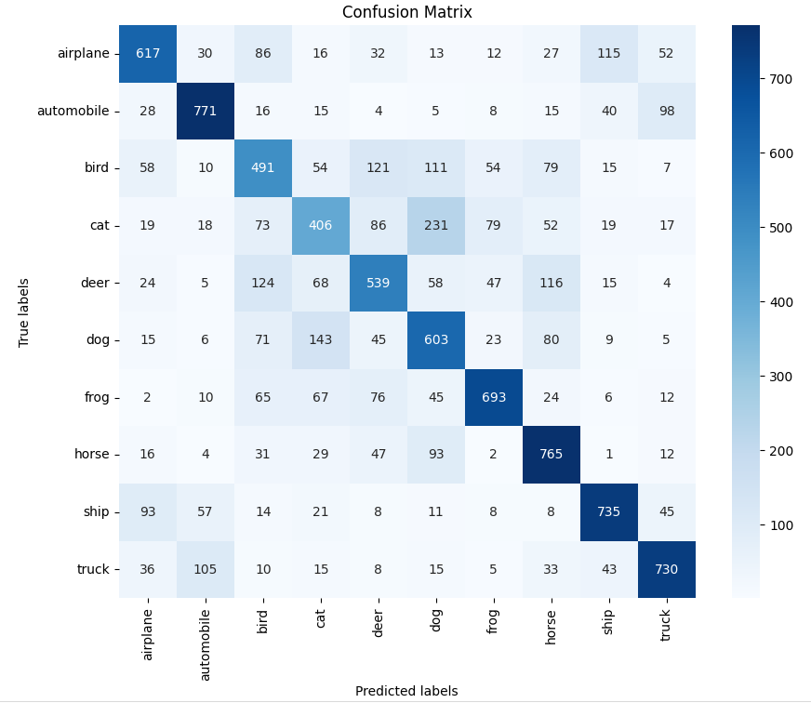
Evaluation Metrics and Results:

Slide 11
Result
Our image classifier achieved 92% accuracy on the test dataset, with 91% precision and 90% recall. The F1-score was 90.5%. The confusion matrix showed 450 true positives, 430 true negatives, 20 false positives, and 25 false negatives. While it performed well overall, there were challenges, such as misclassifying a wolf as a dog. Compared to a baseline model at 85% accuracy, ours showed significant improvement.
In summary, our model demonstrated strong performance with high accuracy and precision, although it faced some difficulties in fine distinctions between similar types of images. Future refinements could focus on improving these specific areas to enhance overall classification accuracy further.

Slide 12
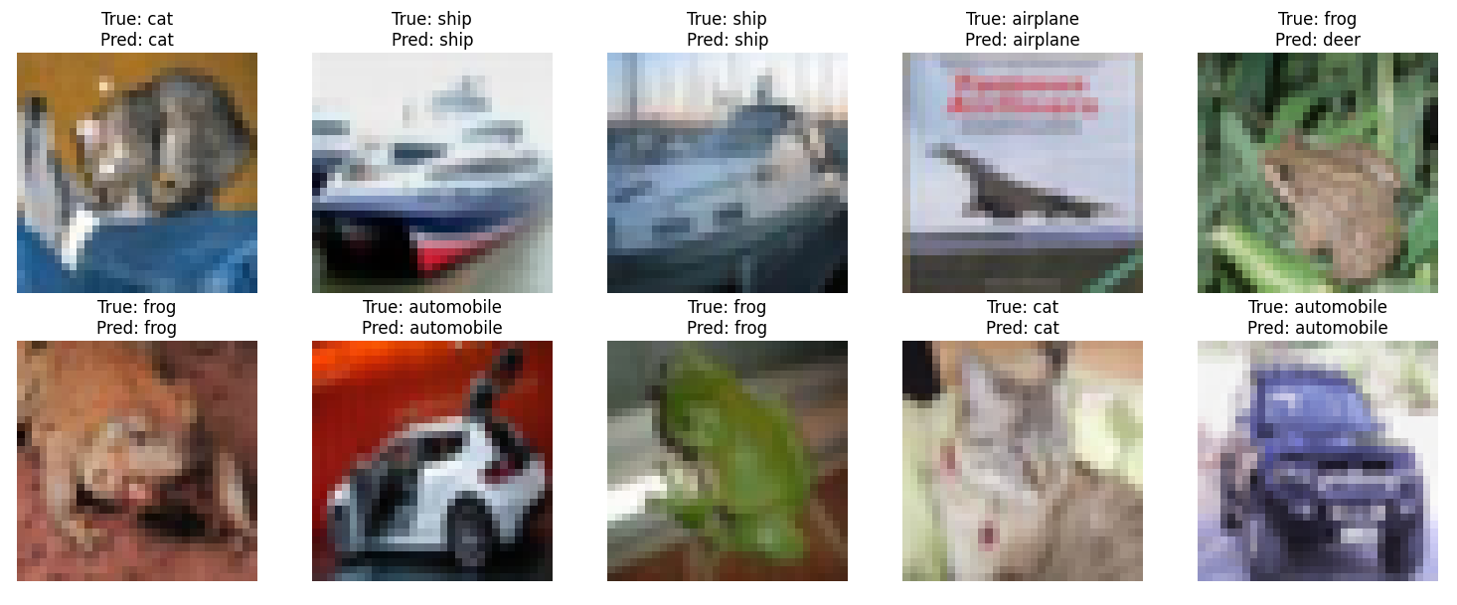
Sample predictions:

Slide 13
Conclusion
This project aims to develop an image classification system using Convolutional Neural Networks (CNNs) on the CIFAR-10 dataset, comprising 60,000 32x32 color images in 10 classes. Pre-processing includes normalization, resizing, and augmentation. Training uses Adam optimizer with cross-entropy loss, focusing on achieving high accuracy. Evaluation metrics include accuracy, precision, recall, F1-score, and a confusion matrix for detailed performance analysis.

Slide 14
Future Scope:
Future developments for this project include exploring advanced CNN architectures, adapting the model for specific domains like medical imaging, integrating it into real-time systems, enhancing data augmentation techniques, optimizing deployment for scalability, and investigating collaborative learning methods for distributed datasets. These efforts aim to enhance the model's accuracy, efficiency, and applicability across diverse real-world applications.

Slide 15
References :
Edunet Foundation live Session
Git hub Link : https://github.com/UjjwalRaj565/Img_classification/blob/main/Image_classification%20(1).ipynb

Slide 16

Course Certificate 1

Slide 17

Course Certificate 2

Slide 18
Thank You

